Slide 1
Open Closed Principle
Case Study – Multiple GUI Platforms
Dr. Clarence LAU

Slide 2
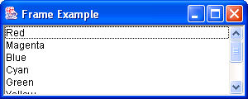
Problem
Eric is a young programmer. He has written a program to display a list of colors using the Java AWT package (Frame2.java) for the GUI.

Slide 3
Problem (cont)
He submits the program to his supervisor John. John wants Eric to revise the program so that it can be easily extended to use either the Java AWT package, Java Swing, or even IBM SWT package for the GUI.
Codes for GUI will change when the GUI platform changes

Slide 4
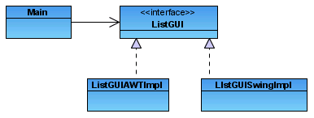
Solution
Solution: separate the GUI codes from the other codes.
How?
Put the non-GUI codes into a class which depends on a public interface and the GUI codes into other classes which implement the interface.

Slide 5
Identify GUI Codes
import java.awt.*;
import java.awt.event.*;
public class Frame2 extends Frame {
private Closer Handler;
private List Selector;
private String ColorList[];
Frame2 () {
Handler = new Closer ();
setTitle ("Frame Example");
setSize (300,120);
Selector = new List ();

Slide 6
Identify interface between GUI-codes and Non-GUI codes
ColorList = new String[9];
/* Decoration */
ColorList [0] = "Red";
ColorList [1] = "Magenta";
ColorList [2] = "Blue";
ColorList [3] = "Cyan";
ColorList [4] = "Green";
ColorList [5] = "Yellow";
ColorList [6] = "White";
ColorList [7] = "Gray";
ColorList [8] = "Black";
for (int i = 0; i < ColorList.length; ++i) {
Selector.add (ColorList [i]);
}
The Non-GUI codes
interacts with the GUI codes
Data from
Non-GUI codes
GUI code

Slide 7
Identify GUI Codes (cont)
add(Selector, BorderLayout.CENTER);
addWindowListener (Handler);
show ();
}
public static void main (String args[]) {
Frame f;
f = new Frame2 ();
}
}
class Closer extends WindowAdapter {
public void windowClosing (WindowEvent event) {
System.exit (0);
}
}

Slide 8
Main.java
public class Main {
private String ColorList[];
private ListGUI listDisplay;
public Main(String className) {
ColorList = new String[9];
ColorList [0] = "Red"; ColorList [1] = "Magenta"; ColorList [2] = "Blue";
ColorList [3] = "Cyan"; ColorList [4] = "Green"; ColorList [5] = "Yellow";
ColorList [6] = "White"; ColorList [7] = "Gray"; ColorList [8] = "Black";
try {
// listDisplay = (ListGUI) new className();
listDisplay = (ListGUI)Class.forName(className).newInstance();
listDisplay.displayColors(ColorList);
} catch (Exception e) {
e.printStackTrace();
}
}

Slide 9
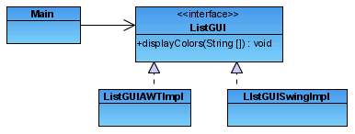
Main.java
public static void main (String args[]) {
Main m = new Main(args[0]);
}
}
Class class = Class.forName(String className) is used to load a class
Design of Solution

Slide 10
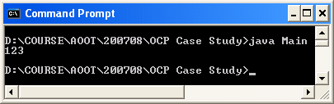
Example for Class.forName
public class Main {
public static void main(String[] args) {
Class c;
try {
  // load StringBuffer
  c = Class.forName("java.lang.StringBuffer");
  // object = new StringBuffer()
  Object object = c.newInstance() ;
  // cast object to be StringBuffer object
  StringBuffer stringbuf = (StringBuffer) object;
  stringbuf.append("123");
  System.out.println(stringbuf);
} catch (Exception e) {
e.printStackTrace();
}
}
}

Slide 11
ListGUI.java
public interface ListGUI {
public void displayColors(String[] colors);
}

Slide 12
ListGUIDisplayAWTImpl.java
import java.awt.*;
import java.awt.event.*;
public class ListGUIAWTImpl extends Frame implements ListGUI {
private Closer Handler;
private List Selector;
public ListGUIAWTImpl () {
Handler = new Closer ();
setTitle ("Frame Example");
setSize (300,120);
Selector = new List ();
add(Selector, BorderLayout.CENTER);
addWindowListener (Handler);
show();
}

Slide 13
ListGUIDisplayAWTImpl.java (cont)
public void displayColors(String[] ColorList ) {
for (int i = 0; i < ColorList.length; ++i) {
Selector.add (ColorList [i]);
}
}
}
class Closer extends WindowAdapter {
public void windowClosing (WindowEvent event) {
System.exit (0);
}
}

Slide 14
ListGUIDisplaySwingImpl.java
import java.awt.*;
import java.awt.event.*;
import javax.swing.*;
public class ListGUISwingImpl extends JFrame implements ListGUI
{
private JPanel topPanel;
private JList listbox;
public ListGUISwingImpl() {
// Set the frame characteristics
setTitle( "Simple ListBox Application" );
setSize( 300, 100 );
setBackground( Color.gray );
// Create a panel to hold all other components
topPanel = new JPanel();
topPanel.setLayout( new BorderLayout() );
getContentPane().add( topPanel );
setVisible( true );
}

Slide 15
ListGUIDisplaySwingImpl.java
(cont)
public void displayColors(String[] ColorList ) {
// Create a new listbox control
listbox = new JList( ColorList );
topPanel.add( listbox, BorderLayout.CENTER );
invalidate(); // mark all components to be layouted
validate(); // layout the Frame again
}
}

Slide 16
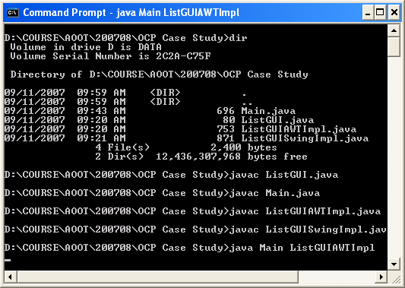
Compile & Run
The Main class depends only on the interface.

